Slide 1


ASTOS UI Overview –
Sub-Orbital Rocket Trajectory Modelling
Jason Ong

Slide 2

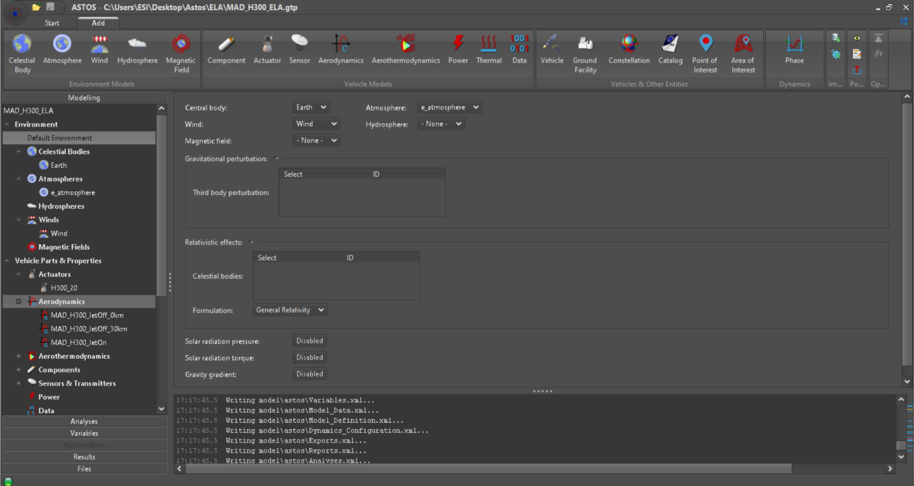
Component Panel
UI Tree

Slide 3
Environment Settings

Slide 4
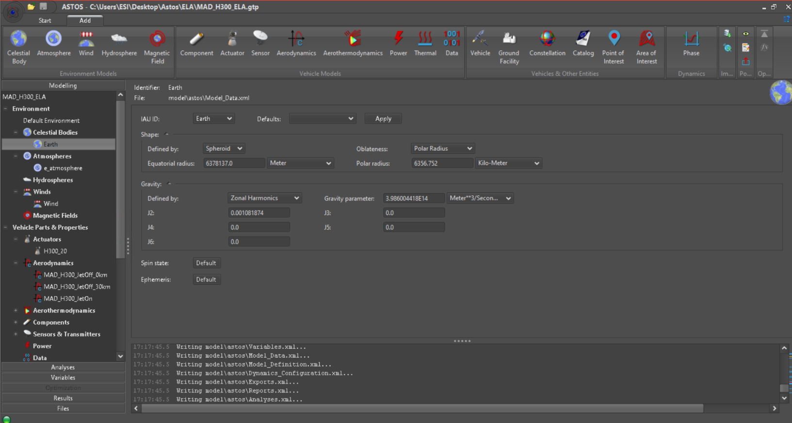
Earth Model Set-Up

Slide 5
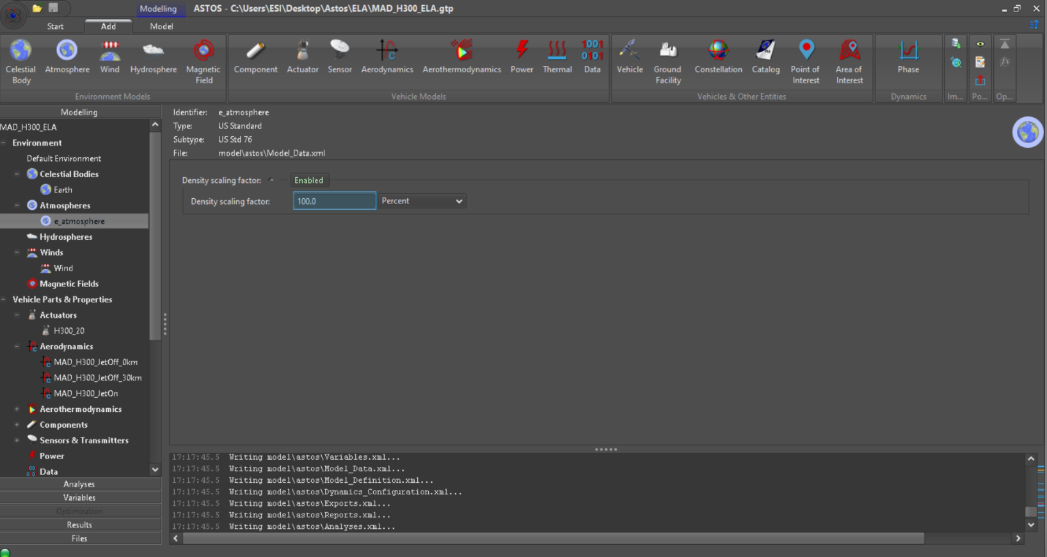
Atmospheric Model
Density Scaling
Blue box for Monte Carlo adjustments (to be covered later on)

Slide 6
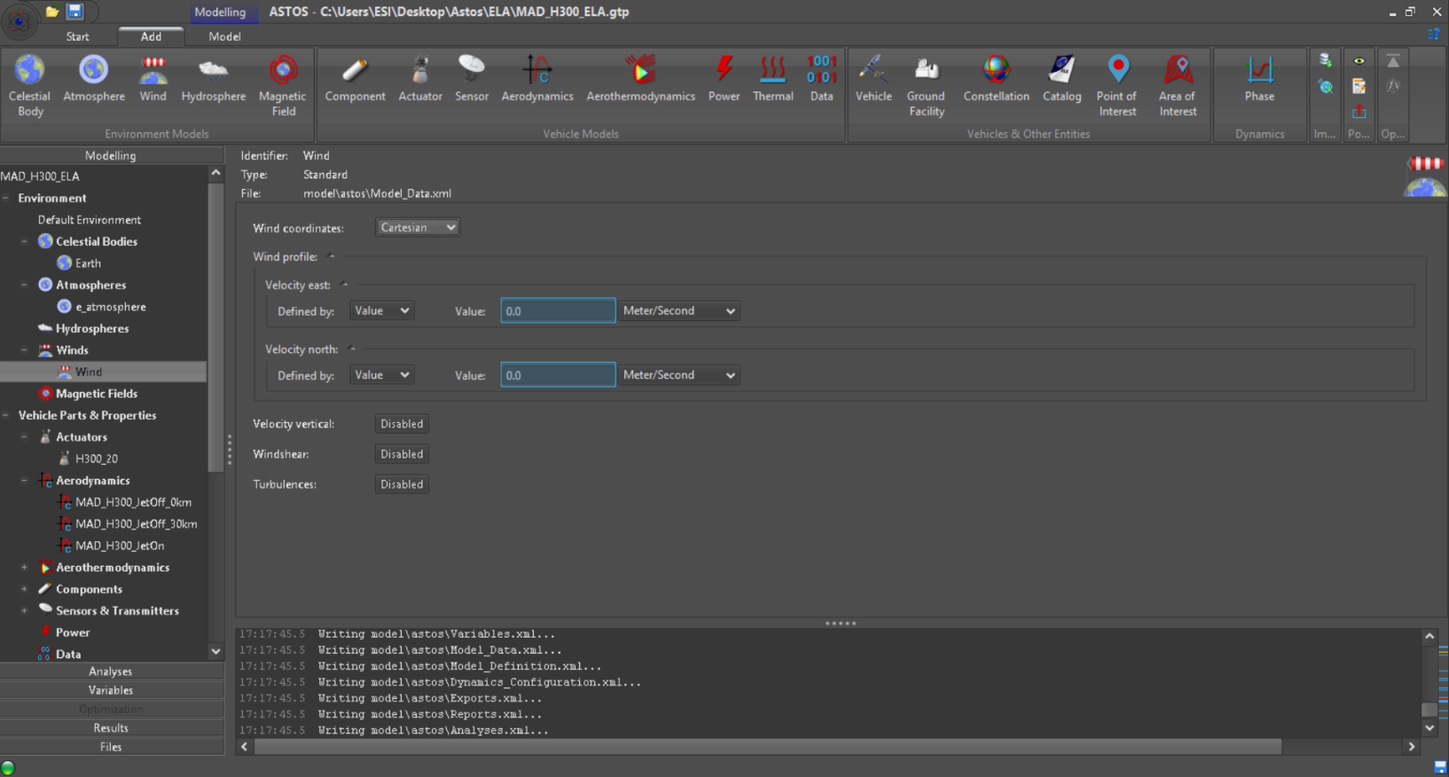
Wind Profile
Can be set in cartesian or cylindrical coordinates
Turbulence profiles not enabled due to licensing

Slide 7
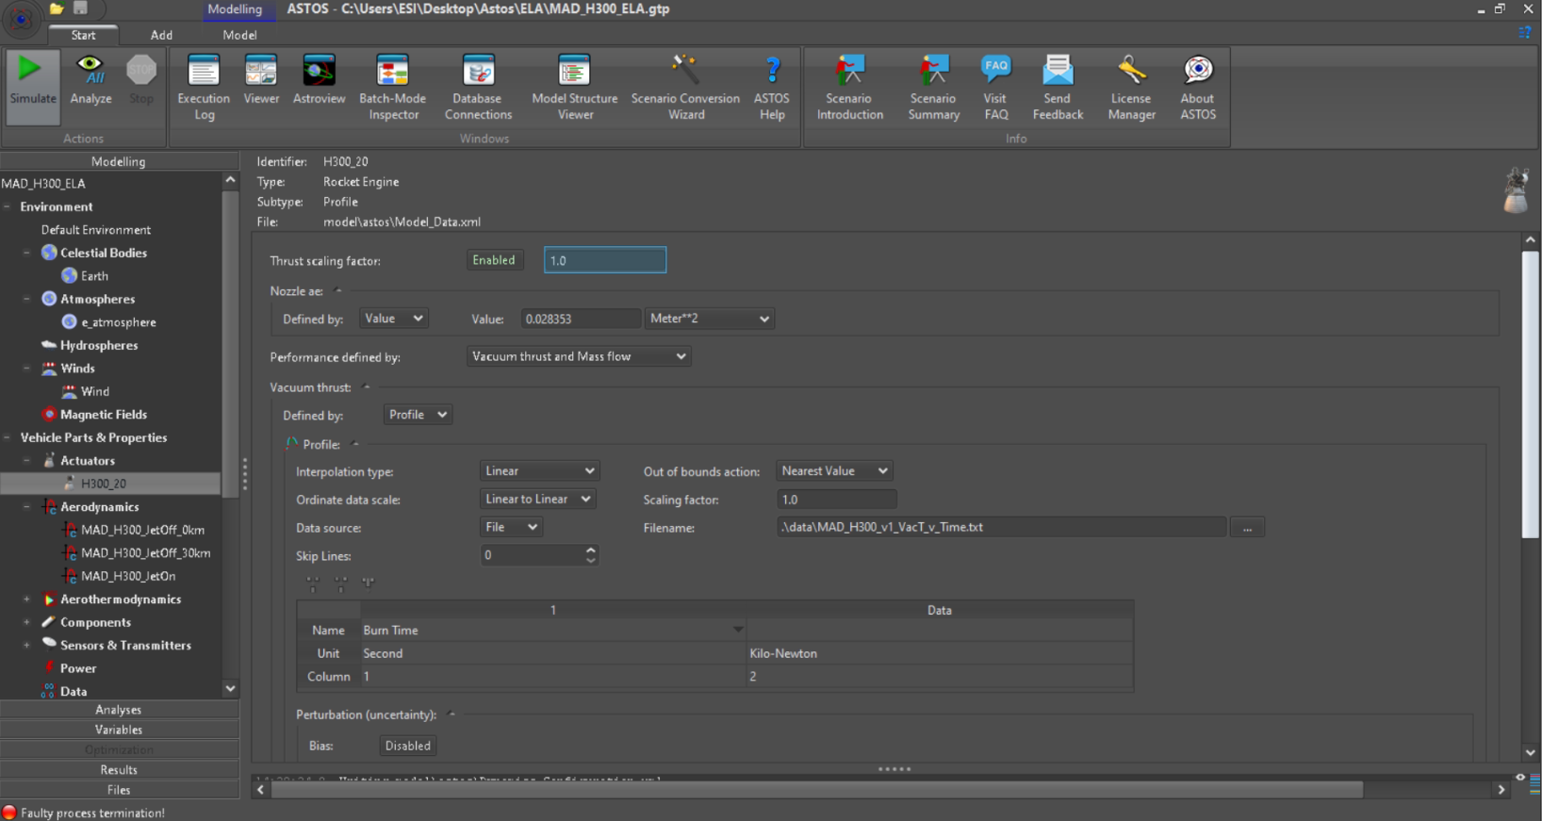
Engine Settings
Nozzle exhaust area
Thrust data (file or manual input)

Slide 8
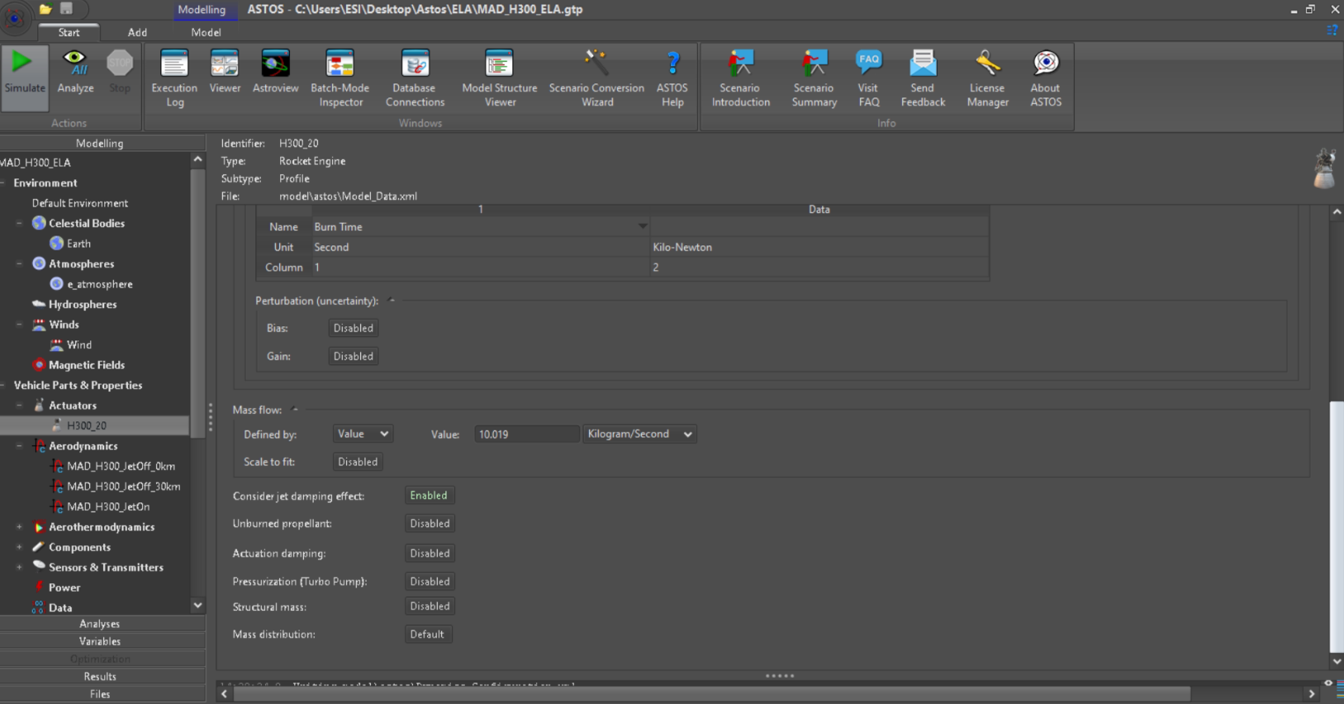
Engine Settings
Mass flow data (file or manual input)

Slide 9
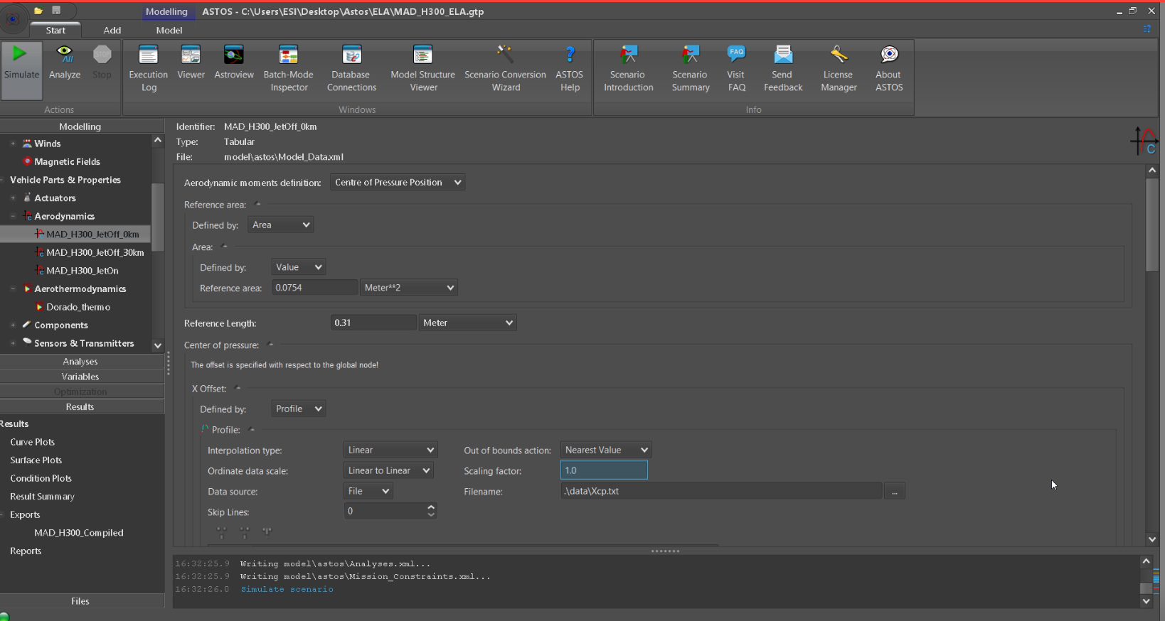
Aerodynamics
Reference area and length

Slide 10
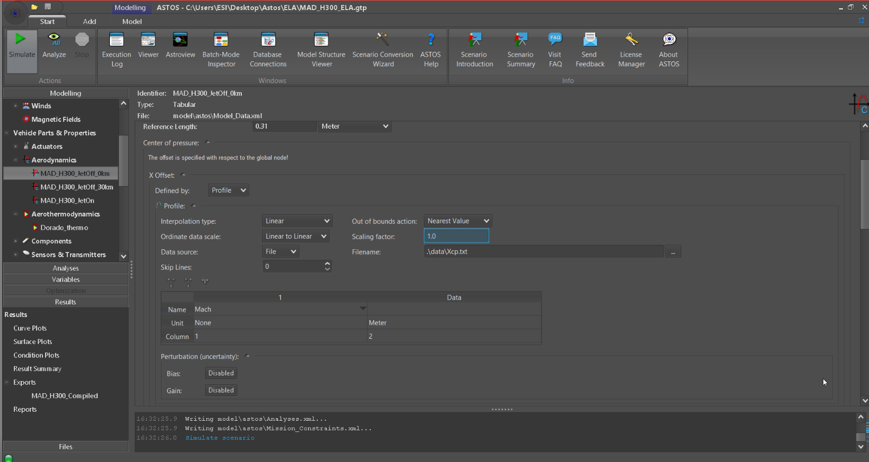
Aerodynamics
XCP input
Matching descriptors for file input

Slide 11
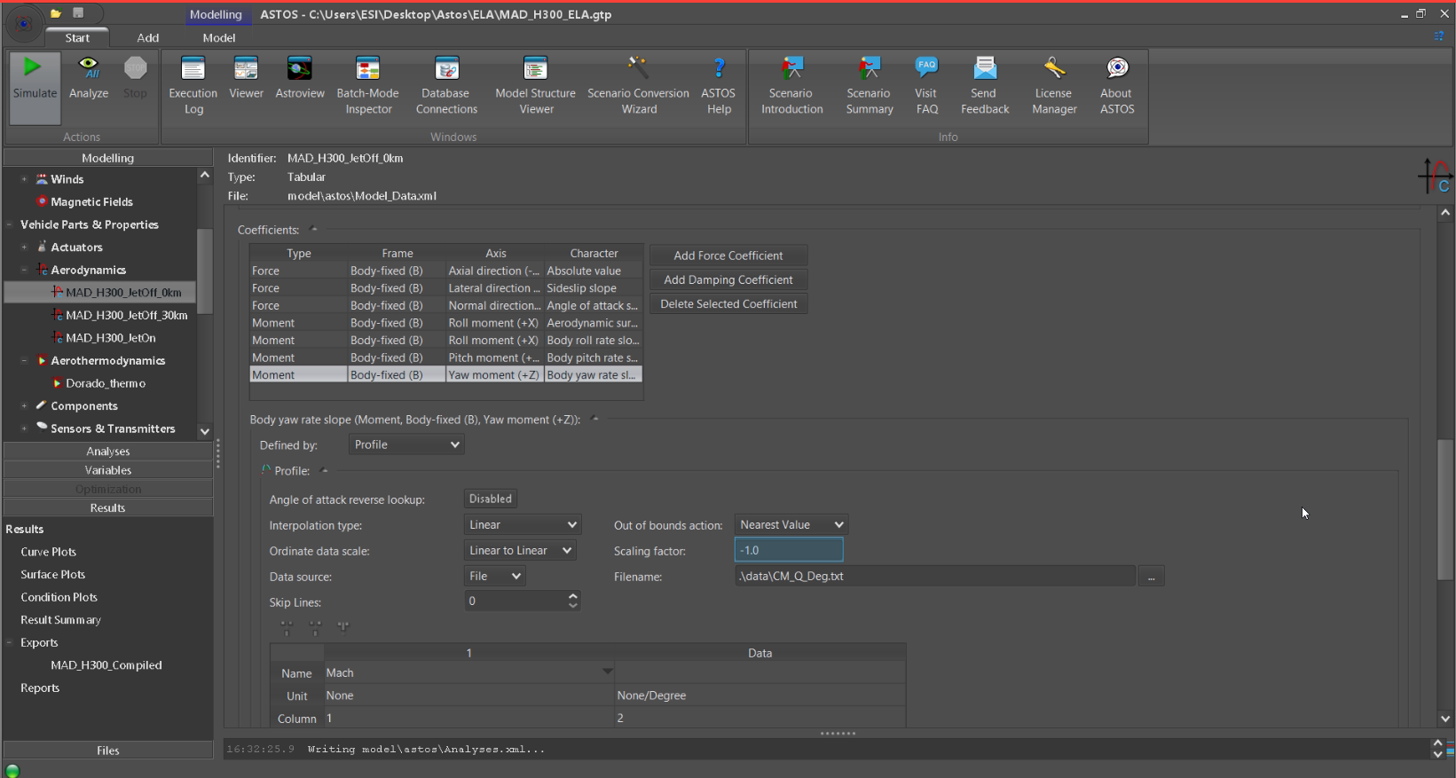
Aerodynamics
Force and moment coefficients definition
File/individual data input for force/moment coefficients

Slide 12
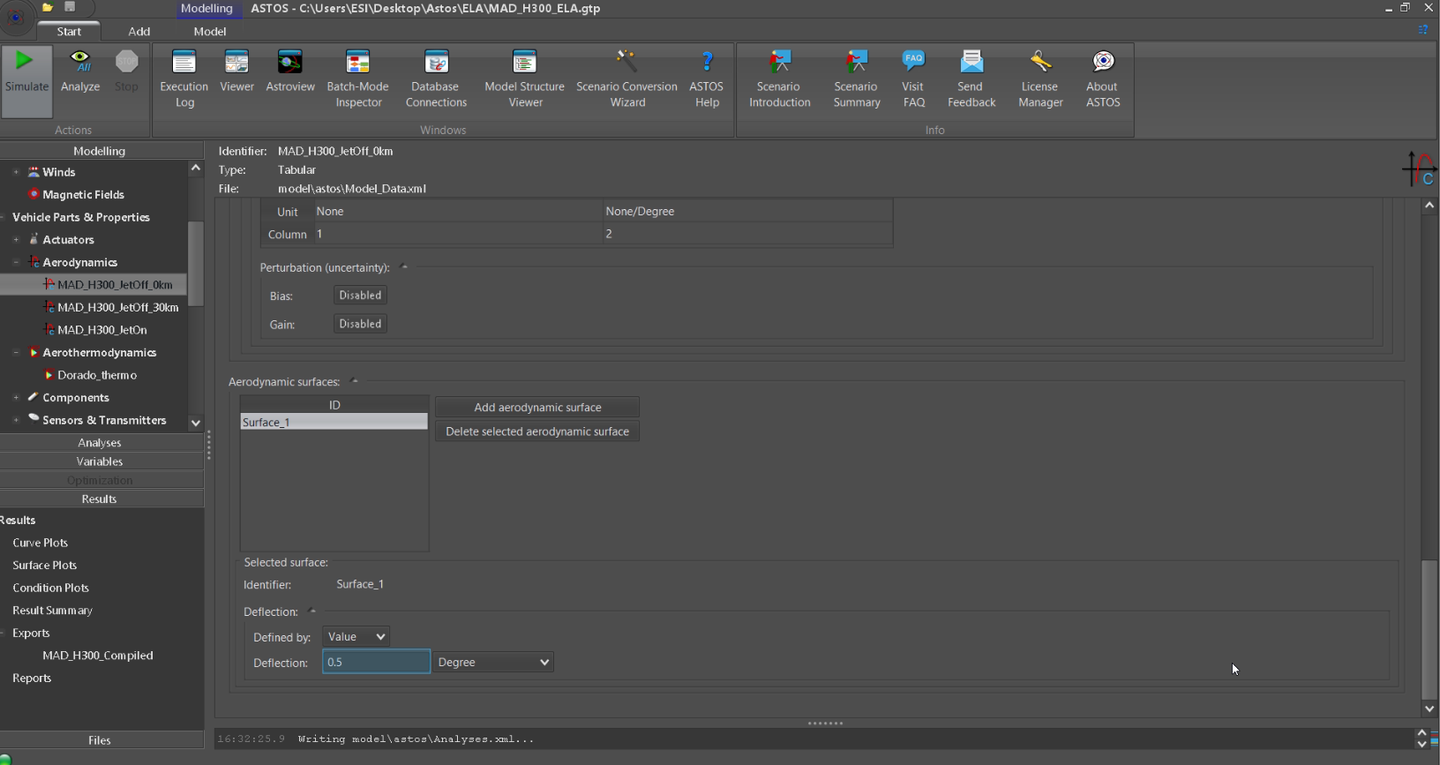
Aerodynamics
Specify fin surfaces and fin cant angle

Slide 13
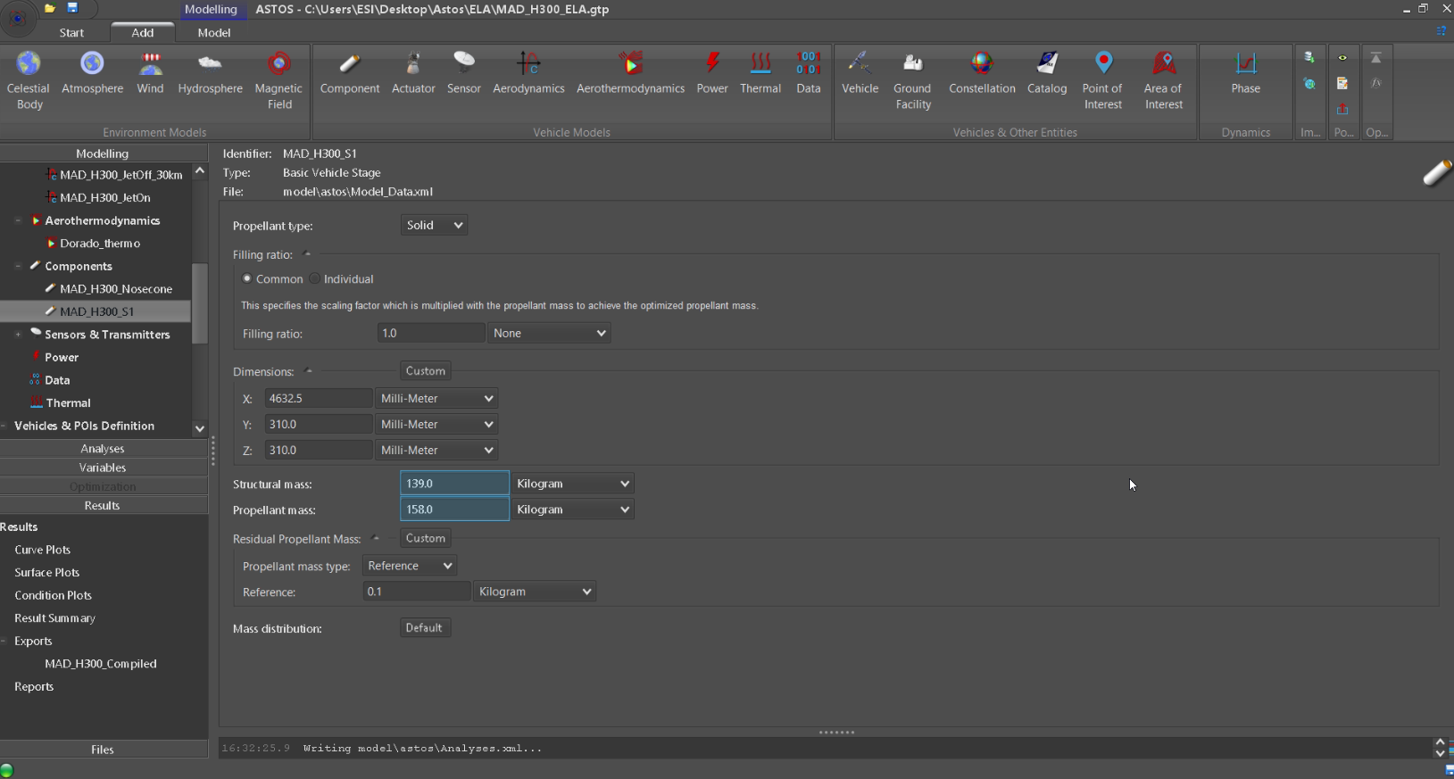
Components - Stage
Dimensions and mass specifications

Slide 14
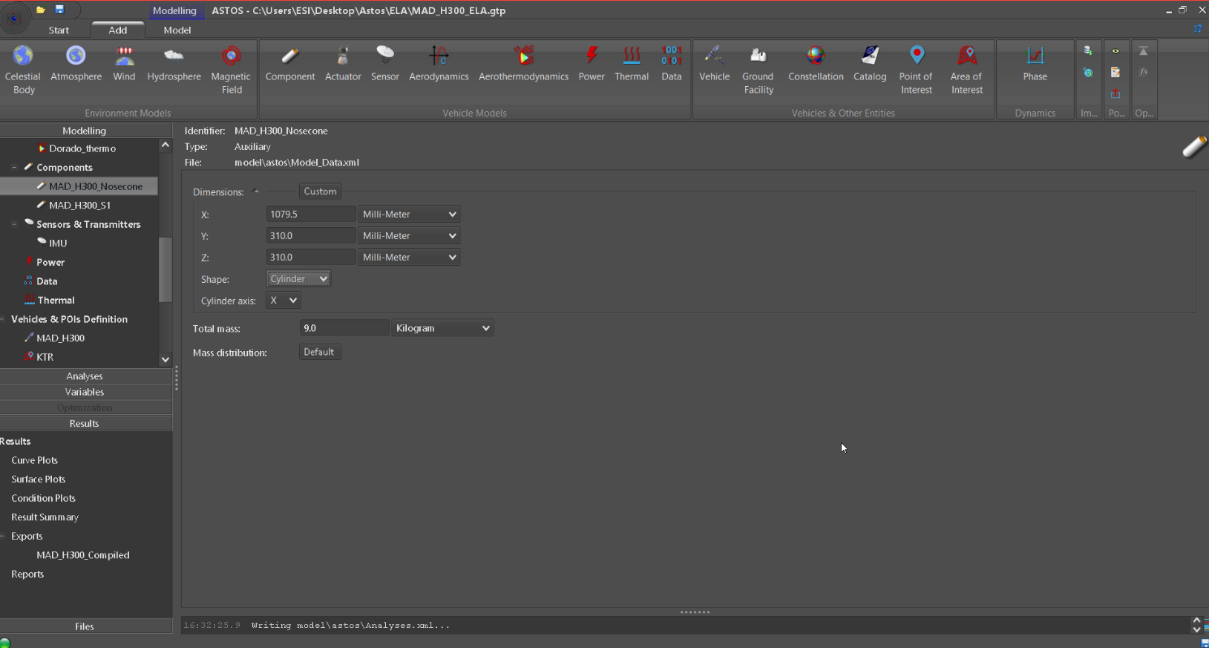
Components - Auxiliary
Dimensions and mass specifications

Slide 15
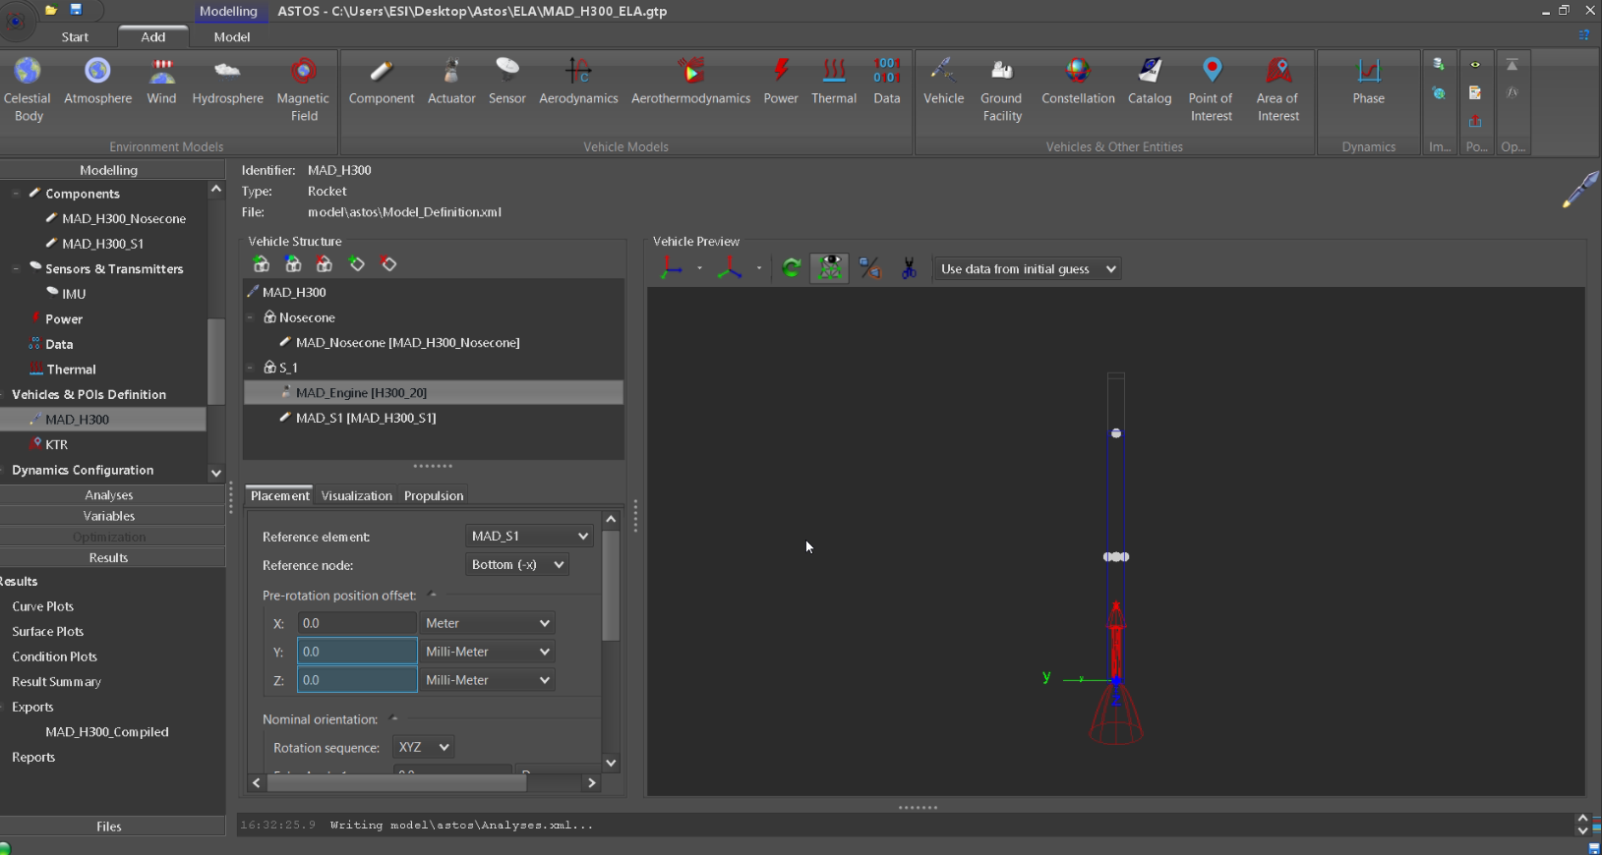
Component Inclusion
Vehicle Definition
Node Visualization
Node
Placement

Slide 16
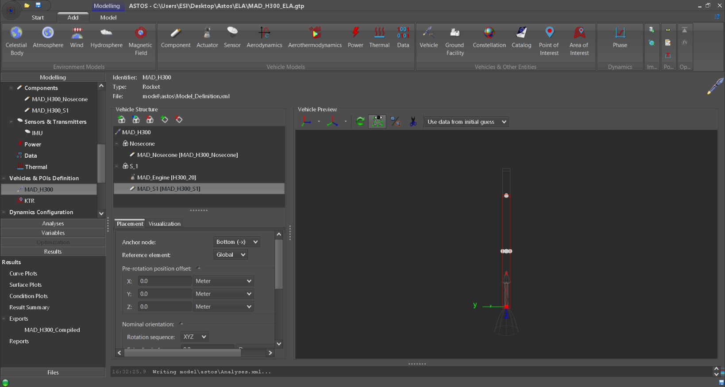
Vehicle Definition
X Offset values are measured from global node
Global node

Slide 17
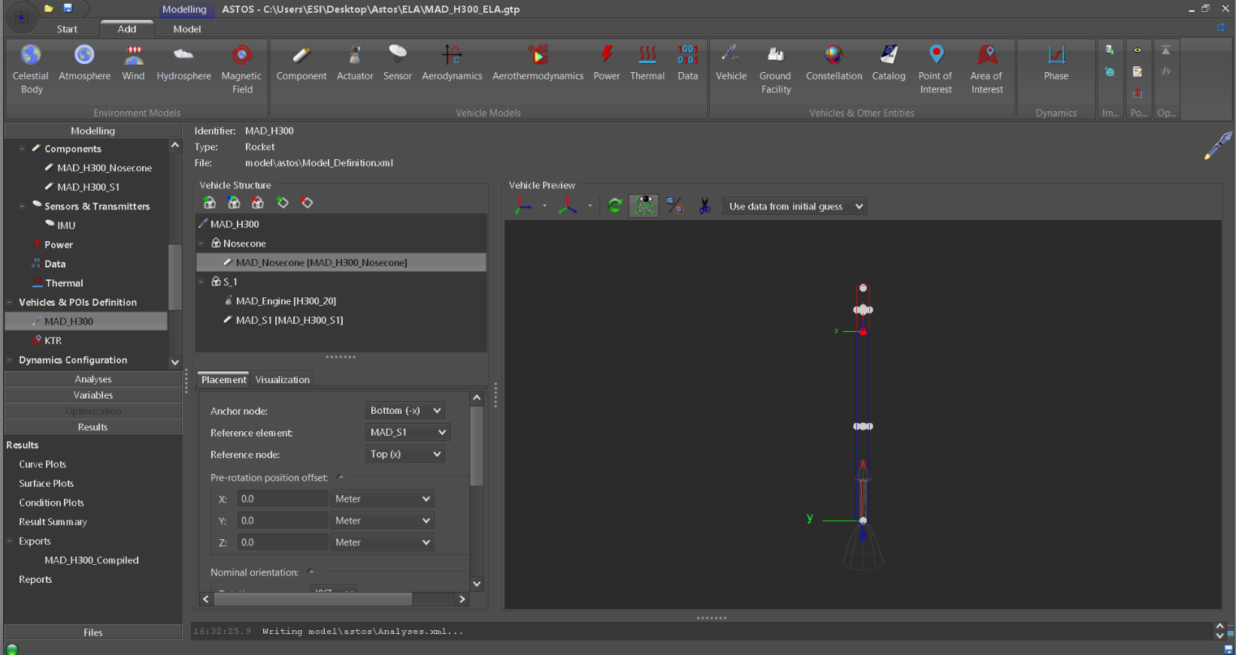
Vehicle Definition
Nosecone
Top node of MAD_S1
MAD_S1
Node placement for other components
Global node
MAD_Engine

Slide 18
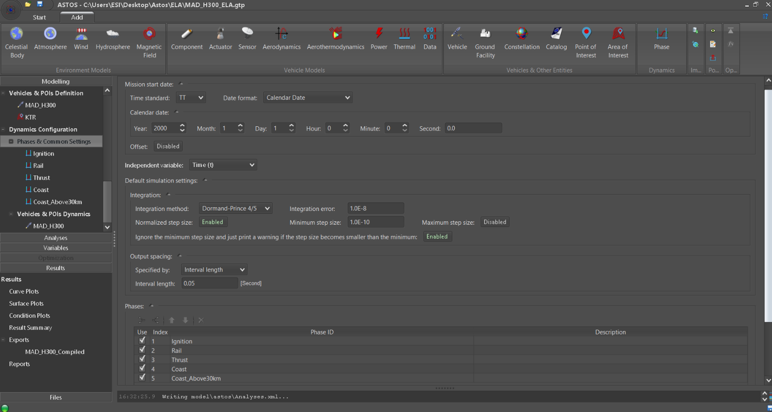
Phase Settings
Temporal discretization
“Checked” status – to be computed

Slide 19
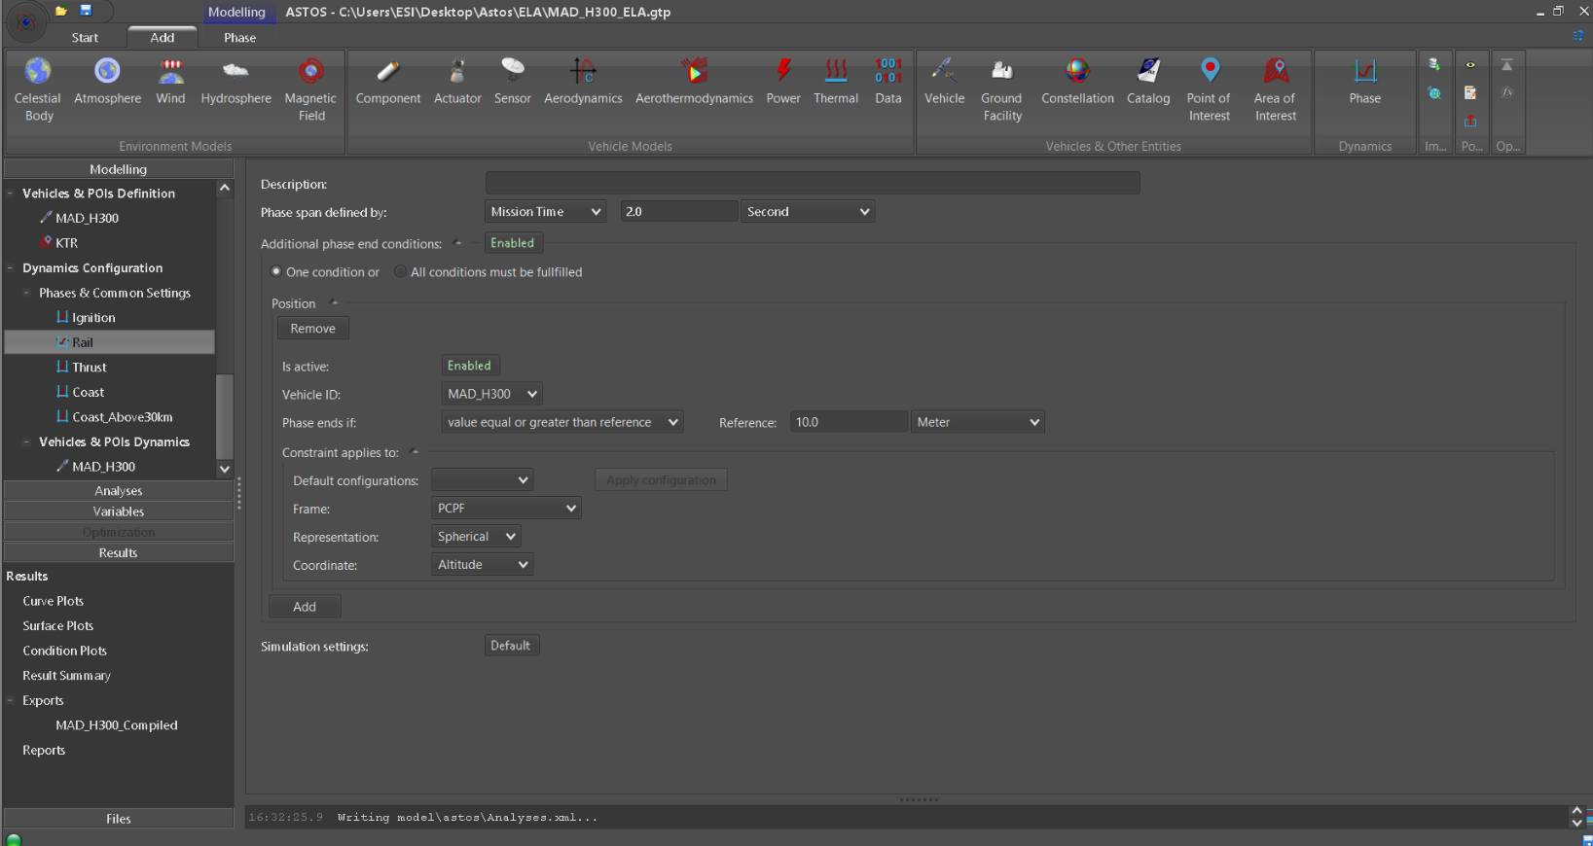
Phase Settings
Specify length of phase (based on duration or end-point using mission time)
Boolean condition for end-of-phase

Slide 20
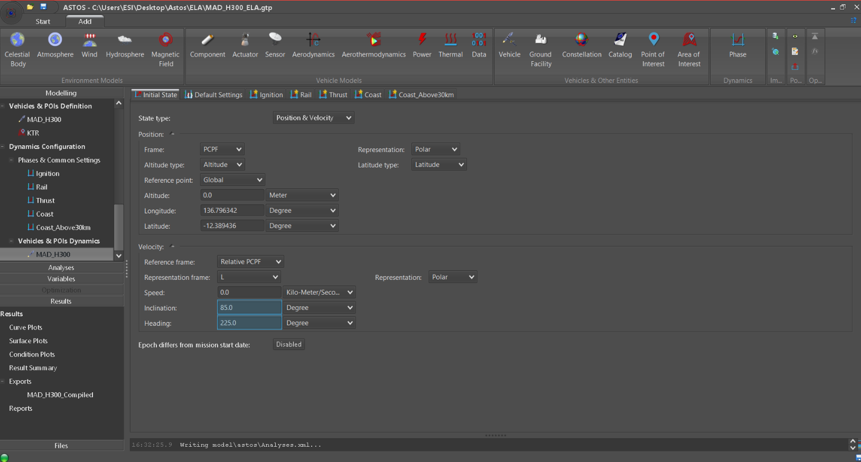
Dynamics Settings
Initial lat, long, alt specification
Launch angle and azimuth

Slide 21
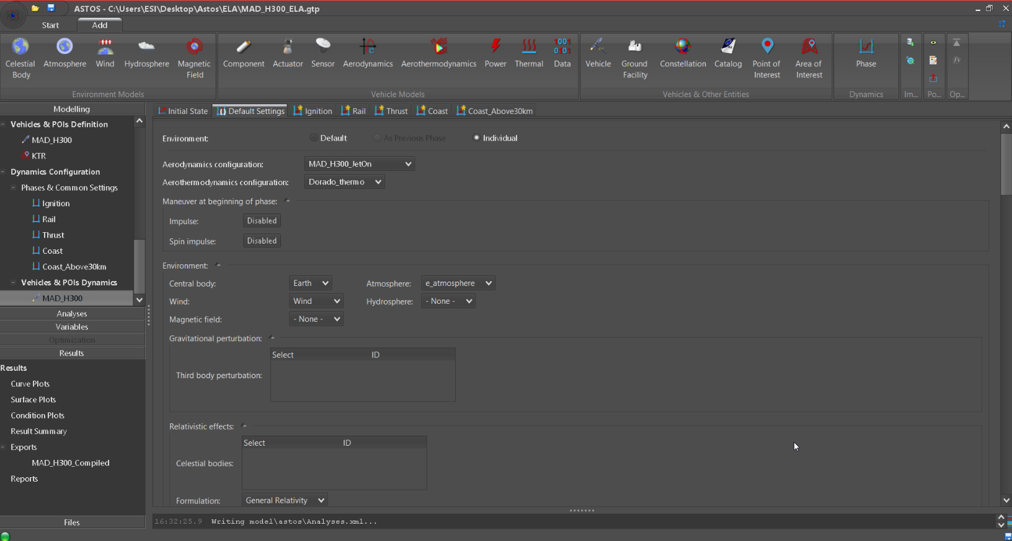
Dynamics Settings
Aerodynamics
Environment specifications

Slide 22
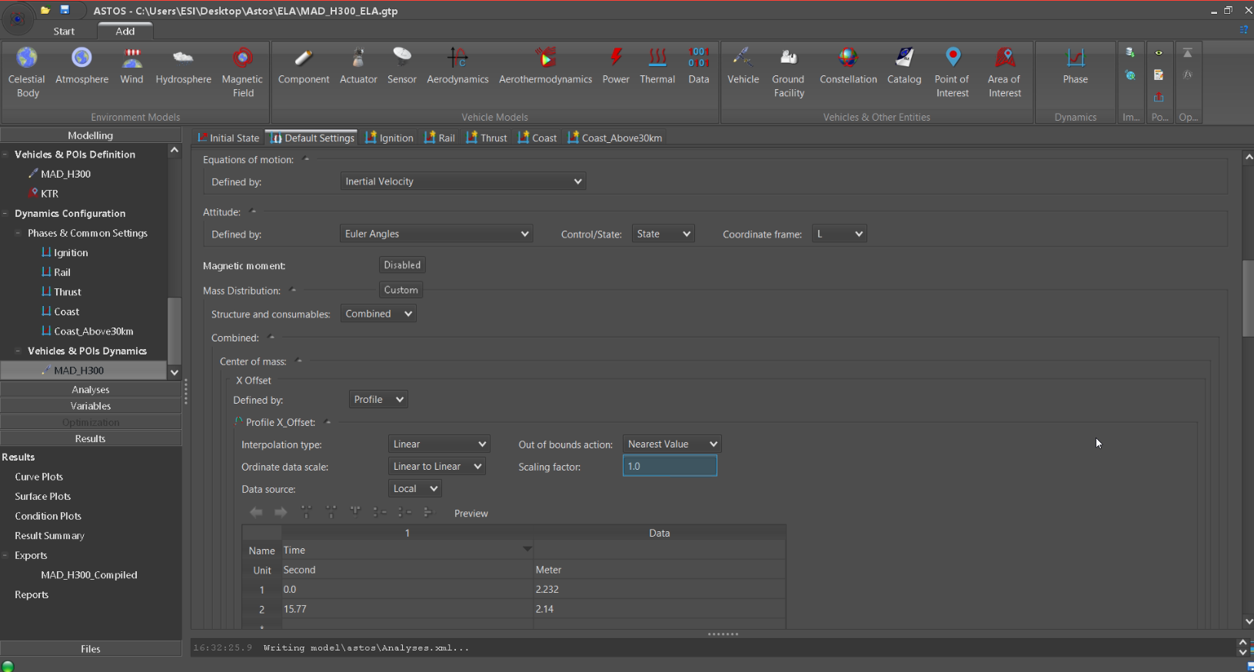
Dynamics Settings
Equations of motion
Attitude Control
CG input

Slide 23
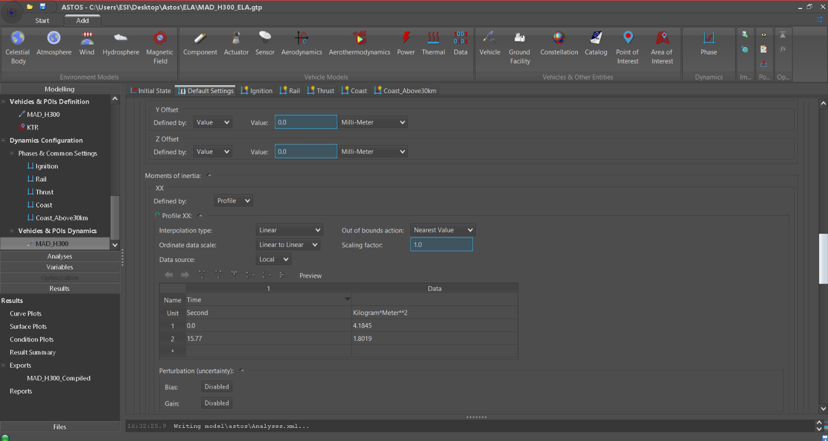
Dynamics Settings
CG Input (Y and Z Offsets)
MOI Input XX

Slide 24
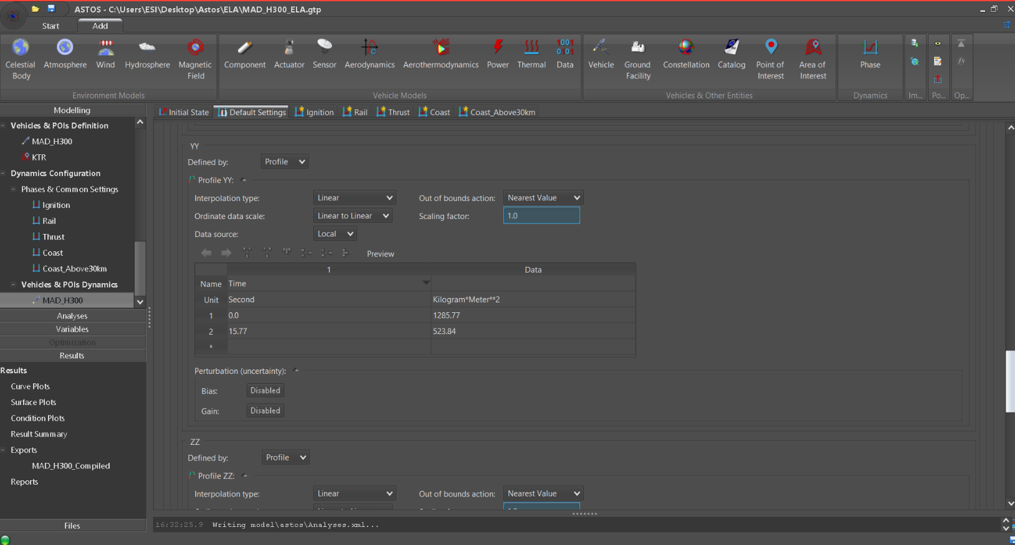
Dynamics Settings
MOI Input YY (Same for ZZ)

Slide 25
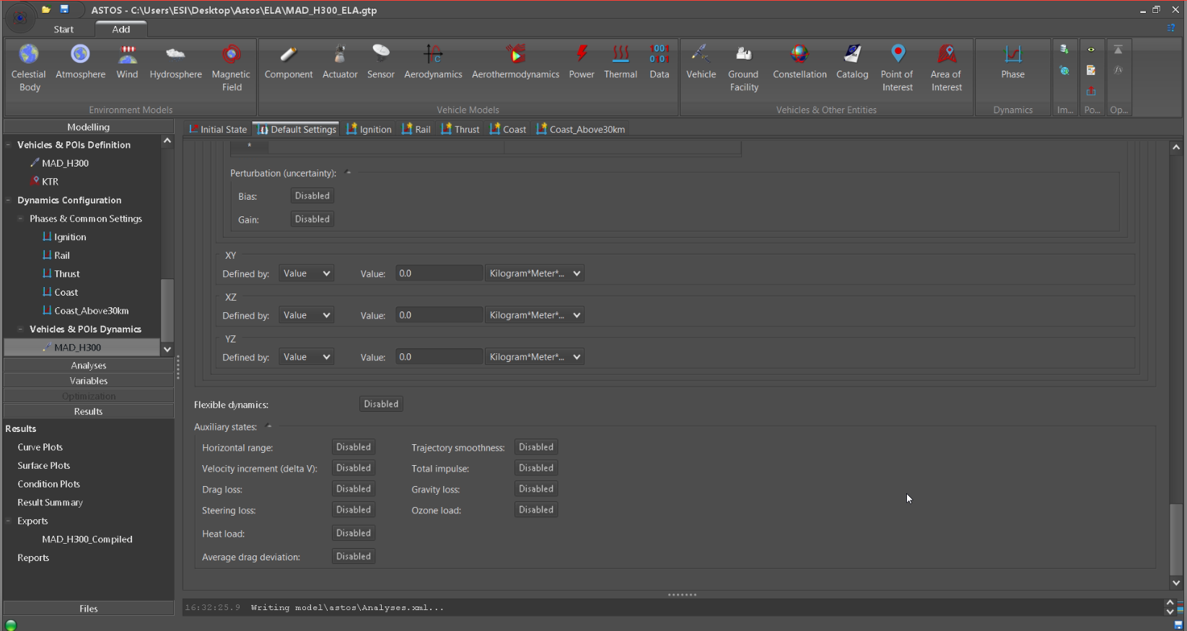
Dynamics Settings
MOI Input XY, XZ, YZ

Slide 26
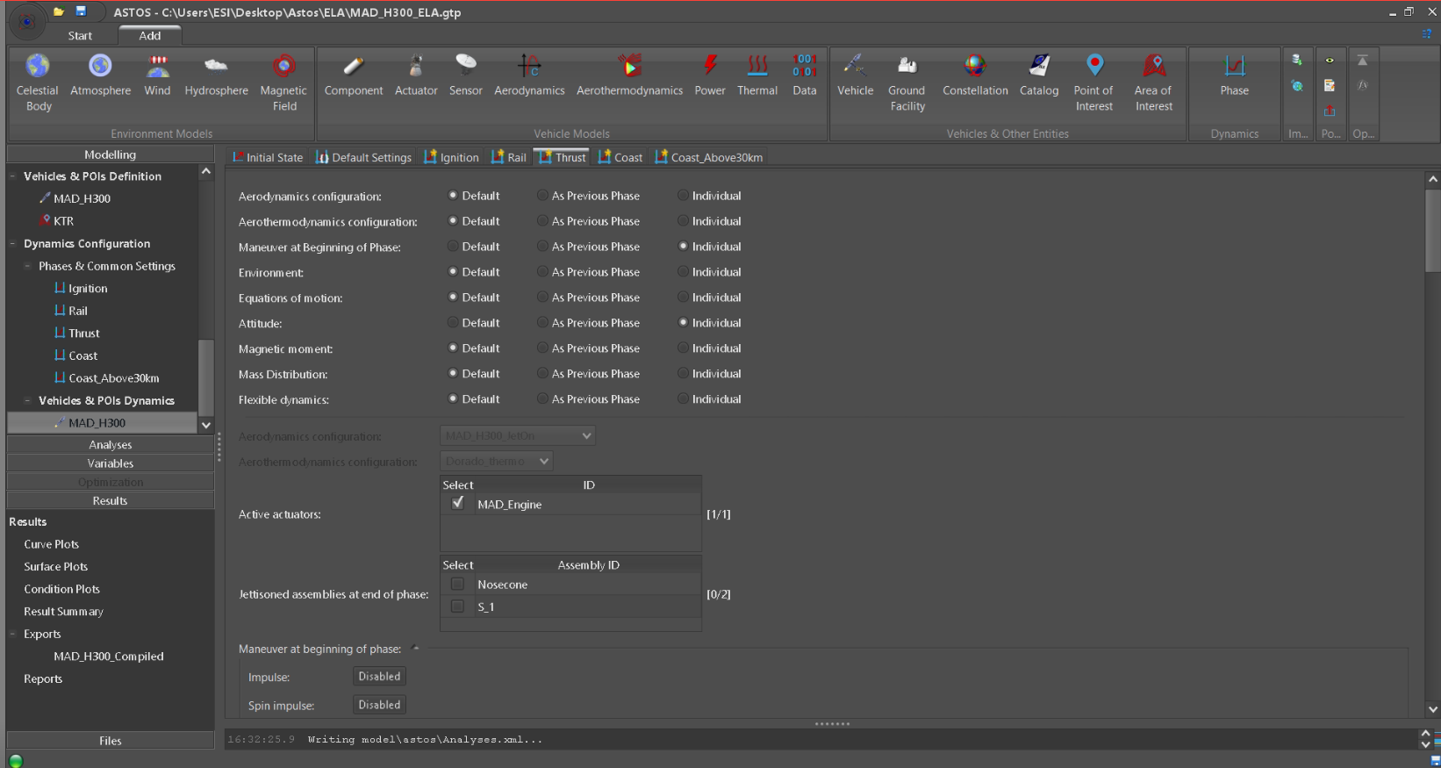
Dynamics Settings
Dynamics customization depending on phases

